Slide 1
Sexual Violence And Disability: Law, Practice And Access To Justice
Dariana Gryaznova
Eurasia Legal Advisor
Equality Now
https://equalitynow.org/

Slide 2
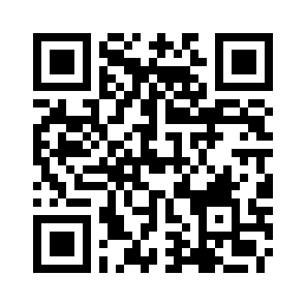
Equality Now’s Work Formats
Reports
Sexual Violence And Disability In Kyrgyzstan: Law, Policy, Practice And Access To Justice (2023)
Navigating The Justice System As A Sexual Violence Survivor With Disabilities (online webpage)
Sexual Violence Against Women and Girls with Disabilities in Central Asia (upcoming)
Submissions to Regional and International Human Rights Mechanisms
CAT, CCPR, CEDAW, CRPD, CRC, CSW, EU Human Rights Dialogues, UPR
Strategic Litigation

Slide 3
Barriers to Access to Justice in SV Cases
Sexual violence remains significantly underreported
There is a lack of a consent-based definition of rape
Burdensome and discriminatory evidentiary standards continue to persist
Survivors face a severe lack of support services
Deeply entrenched patriarchal attitudes, gender stereotypes, disbelief, and humiliation from law enforcement and forensic experts, as well as victim-blaming by relatives and communities, leave the overwhelming majority of sexual violence crimes unpunished
If the survivor has a disability, these barriers are further compounded, making access to justice and support even more challenging

Slide 4
Lack of Mechanisms to Identify and Monitor Women and Girls with Disabilities at Risk
There is a lack of an effective system to identify, monitor, and assist women and girls with disabilities who are at risk of, or experiencing, gender-based violence, particularly sexual violence
Women and girls in psychiatric and psychoneurological institutions, social care homes, and other residential facilities face a heightened risk of sexual violence, compounded by significant barriers to reporting abuse due to institutional power imbalances and the absence of supportive procedures

Slide 5
Gender Stereotypes Against Women and Girls with Disabilities
Patriarchal Attitudes Among Law Enforcement and Judicial Officials
Discriminatory Perceptions, including:
Beliefs that women with disabilities are more likely to lie or fantasize.
Recorded comments such as:
“Who would want to have sex with a woman with a disability?”
“Be thankful he paid attention to you. Who else would have looked at you?”

Slide 6
Burdensome and Discriminatory Evidentiary Standards
In the overwhelming majority of cases, sexual violence crimes are prosecuted only when physical injuries are found on the body of the victim, as well as biological materials associated with a sexual act
Approaches which directly contradict Article 12 of the CRPD still persist

Slide 7
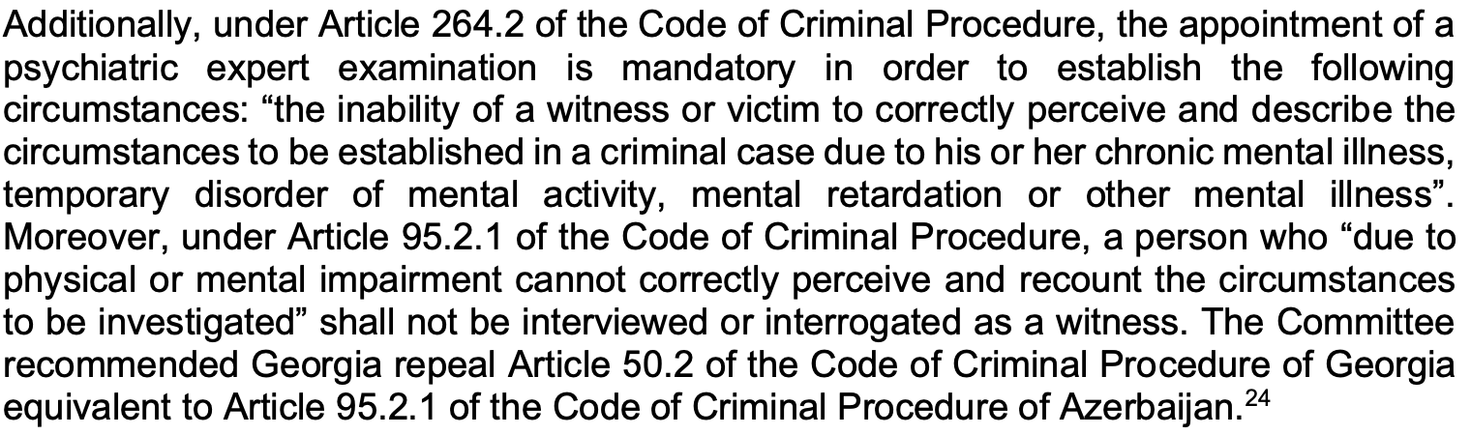
Mandatory Appointment of Psychiatric/ Psychological Expert Examination

Slide 8
Our Key Recommendations
Amend the definition of rape so that it is based on the lack of genuine and voluntary consent, and put in place victim-centred guidelines on how consent should be understood, including in relation to survivors with disabilities
Put in place comprehensive manuals and guidelines for criminal justice professionals, in line with CRPD and CEDAW standards, and provide trainings for law enforcement and the judiciary to effectively respond to and address sexual violence against women and girls with disabilities
Establish victim-centred support services and provide reasonable and procedural accommodation for women and girls survivors of sexual violence during criminal justice processes

Slide 9
Our Key Recommendations (2)
Remove burdensome evidentiary standards and abolish discriminatory provisions preventing women and girls with disabilities from testifying
Collect and analyze administrative data on sexual violence disaggregated by sex, age, disability and other characteristics
Develop and adopt a comprehensive strategy at the level of the Government to overcome negative gender and disability stereotypes and harmful practices and build zero tolerance for all types of violence in order to achieve gender equality

Slide 10
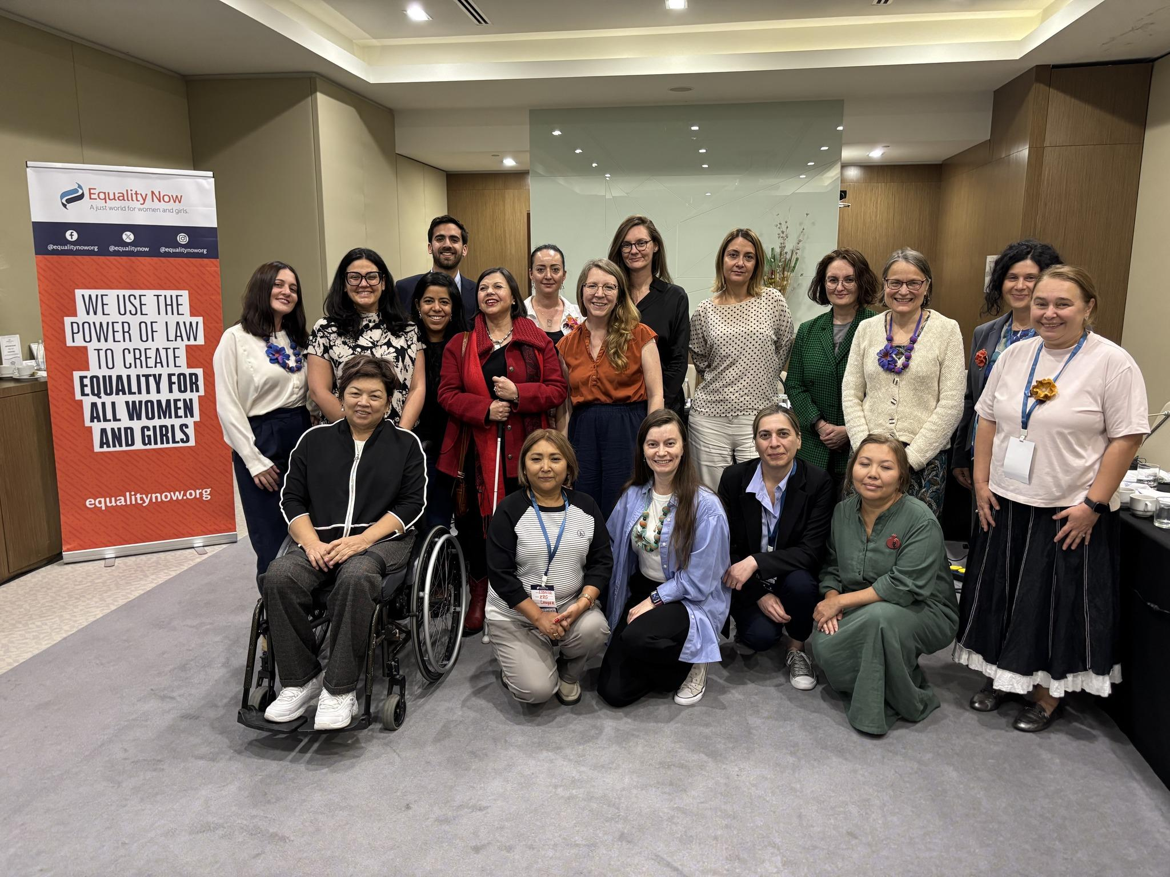
How?
Advocating for Domestic Legal Reforms
Advocating for Changes in Practice
Effectively Investigating, Prosecuting and Adjudicating Sexual Violence Cases with a Particular Focus on Survivors with Disabilities: A Manual for Practitioners in Kyrgyzstan (ongoing work)
A manual for lawyers representing women and girls in sexual violence cases, with a special focus on survivors with disabilities (ongoing work)
Contributing to Global Change
Expert meeting to address violence against women with disabilities (September 2024, Serbia)
A joint letter to the CEDAW Committee proposing a General Recommendation on access to justice for women, adolescents, and girls with disabilities (April 2024)

Slide 11
Thank you!
dgryaznova@equalitynow.org

