Slide 1



HOW TO END FORCED STERILISATION
Good practice example of the criminalisation in Malta with disability-led Reproductive Justice

Slide 2
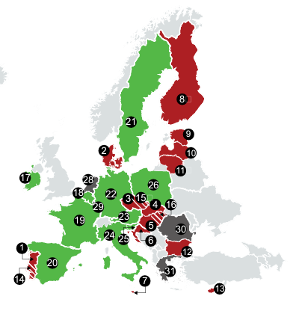
FORCED STERILISATION
Forced sterilisation is an eugenic practice and a violation of sexual and reproductive health and rights, a form of violence against women. It is linked to sexual exploitation.
Only 10 countries criminalise forced sterilisation as a distinct offence.
11 countries do not allow forced sterilisation of persons with disabilities, but is not criminalised.
3 countries (Portugal, Czechia and Hungary) allow it in minors.
Graphic on Status of forced sterilisation in EU Member States on the European Disability Forum 2022 report “Forced sterilisation of persons with disabilities in the EU”

Slide 3
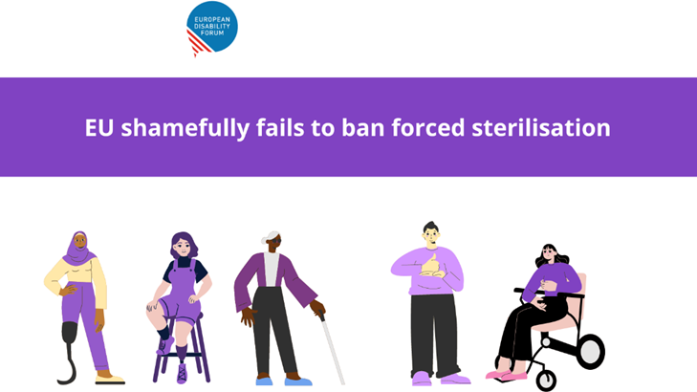
EU LEGISLATION
Forced sterilisation is prohibited by the Article 23 of the United Nations Convention on the Rights of Persons with Disabilities (CRPD) and article 39 of the Istanbul Convention. However, there are no mechanism for enforcement or sanctions.
The EU recently had the opportunity to criminalise forced sterilisation across all of its Member States, through the Directive on combating violence against women, but relevant provisions were removed from the Directive on the insistence of the Council of the EU.

Slide 4
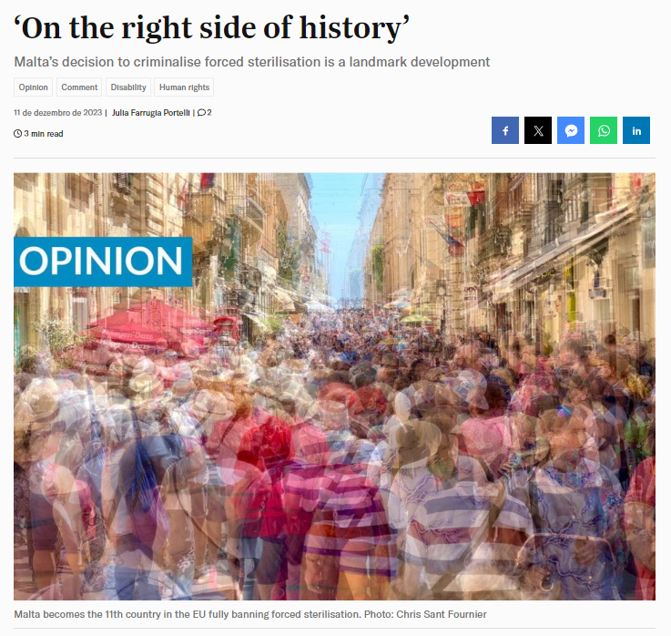
LEGISLATION INFORMED BY LIVED EXPERIENCES
THE MALTA EXAMPLE
Malta became the 10th country to criminalise forced sterilisation in the EU.
Considering the limited research on how and why women and girls with disabilities are being sterilised, the Malta Government involved the voices and lived experiences of disabled-led organisations and disabled advocates, including survivors of forced sterilization, in writing the law.

Slide 5
LEGISLATION INFORMED BY LIVED EXPERIENCES
THE MALTA EXAMPLE
Reasons for forced sterilisation:
Carers and family members concerned about abuse and pregnancy, believing the person couldn’t be a parent;
Institutions which request it as a standard for acceptance into their facilities, with family members having no other service options;
Medical professionals suggest to carers it is the best option;
Menstrual management or to facilitate care.
Consent:
Countries with substituted decision-making in legal capacity allowing legal guardians to give consent (carers, institutions, etc);
Pressured into consent or made to believe their disabilities would not allow them to be mothers
Not being fully or clearly informed of what the procedure will do,
Not being informed at all, with the woman thinking it was an appendectomy.

Slide 6
LAW IN MALTA
The surgical removal or disablement of a minor or adult’s reproductive organs without that person free and informed consent, leading to sterilisation, leads to a person being guilty of enforced sterilisation, and being liable to imprisonment from 5 to 9 years, with the possibility of a fine.
No substitution of free and informed personal consent, further to the Convention on the Rights of Persons with Disabilities (UNCRPD) in Article 25(d) and General Comment 1.
Accomplices are also covered under this offence.
The punishment increases by one degree, up to a maximum of 12 years when the commission of such crimes involves also the use of force, deceit, fraud, bribery, false pretences, coercion or threats.
The court can additionally impose a fine of between €8,000 and €20,000, and compensation of up to €10,000 for the victim.

Slide 7
LAW IN MALTA
Free and informed consent means:
a) consent reflecting the will and preferences of an adult person, freely given directly by said adult person, in respect of a surgical procedure the adult person might undergo, which may lead to sterilization; and
b) it was given after said adult person has been provided with prior information, in respect of the purpose and nature of the procedure, as well as its consequences, risks, and alternative options thereto, in a manner that is appropriate, accessible and easy to understand for that adult person, including, as necessary, through nonconventional methods of communication and access to independent support from third parties;
c) it can be withdrawn at any moment prior to the procedure following its initially having been given, with said possibility having been likewise communicated to the adult person alongside the information indicated above:
In case the person is unable to give free and informed consent, no other person shall be able to substitute said adult person’s free and informed consent for the purposes of sterilisation.

Slide 8
LAW IN MALTA - exceptions?
There is an exception to this provision which is in the cases that the procedure:
(i) is not performed with the purpose of achieving enforced sterilization in terms of this article; and
(ii) would have been otherwise deemed medically necessary by one (1) or more medical professionals, in accordance with the applicable standard of care, with such standard following established medical practice, and with such medical intervention consisting of one (1) or more procedures, and which has the aim of saving or preserving the life of an adult person or of a minor person, in the immediate or longer term; and
(iii) follows established medical practice with regard to the granting of informed consent by the patient in terms of other legislation.
Safeguard the need for surgical procedures required to save the life of the patient.

Slide 9



CONCLUSION
Research
We need further research to ensure we understand how and why sterilisation is being forced upon women with disabilities and how to stop it.
Legal capacity and Sexual and reproductive rights
Legal capacity laws need to shift across the EU to supported decision-making to fight human rights violations of women with disabilities’ sexual and reproductive rights, including forced sterilisation, contraception, abortion, and others, as well as the provision of inclusive and adapted support.
Inclusive legislation
Legislation that impacts the lives of people with disabilities, especially regarding violence against women, need to not only involve the disability community to ensure its fit for purpose, but to make sure we lead it.

Slide 10
THANK YOU
Do you have any question?
sara.rocha@eucap.eu

