Slide 1


CHAT FOR VICTIMS
Justice that Works: Leveraging Cooperation and Technology for Children, Disability Rights and Gender Equity
Maja Štahan, National Call Centre for Victims of Crime – 116 006

Slide 2




National Call Centre for Victims of Crime – 116 006
Helpline
Email
Referral System
?
Chat
Legal information (rights, criminal and other procedures)
Emotional support for victims, witnesses and their family members
Practical information
Referral to other NGOs and institutions
Assistance in preparing the claim for financial compensation
116 006 helpline is free, anonymous, available 24/7

Slide 3
National Call Centre for Victims of Crime – 116 006
Challenges Faced by Women and Children with Disabilities:
Increased vulnerability to various forms of violence (physical, sexual, emotional, financial abuse)
Physical or communication barriers that hinder access to victim support services (e.g., inaccessible facilities, lack of sign language interpreters, or difficulty understanding written materials)
Social stigma and discrimination that can silence their experiences or make it harder for them to seek help
Isolation, including dependence on caregivers or family members who may be abusers or fail to provide necessary support.
Helpline
Email
Referral System
?
Chat

Slide 4

About the project
Project “Changing the Accessibility of Tools for Victims” (CHAT for Victims) is an European project that aims to improve the support system for victims of crime who are persons with disabilities by implementing a live chat service that is accessible to persons with disabilities, with emphasis on persons with hearing, speech and sight impairments, as well as intellectual and psychosocial disabilities..
  to provide equal access to justice and information for all victims of crime by developing a chat-based online support tailored to the needs of PWDs
  to lay the foundation for providing comprehensive online support via live chat service by conducting research on how to make chat service more accessible
Access to information and effective communication are essential for persons with disabilities (PWDs) who are victims of crime in order to participate effectively in criminal justice process. Unfortunately, the existing means of support are usually hard to access or are completely inaccessible to PWDs.

Slide 5

About the project
Coordinator: Victim and Witness Support Service Croatia, partners on the project:
Victim Support Europe - Belgium
Validity Foundation - Hungary
The Official College of Psychology of Madrid (COPM) - Spain
Centre for Legal Resources (CLR) - Romania
Legal Centre for the Protection of Human Rights and Environment (PIC) - Slovenia
Notes:
Udruga za podršku žrtvama i svjedocima započela je s projektom 1. srpnja 2022. godine.
Projekt je financiran sredstvima Europske komisije u sklopu programa Justice (JUST).

Slide 6
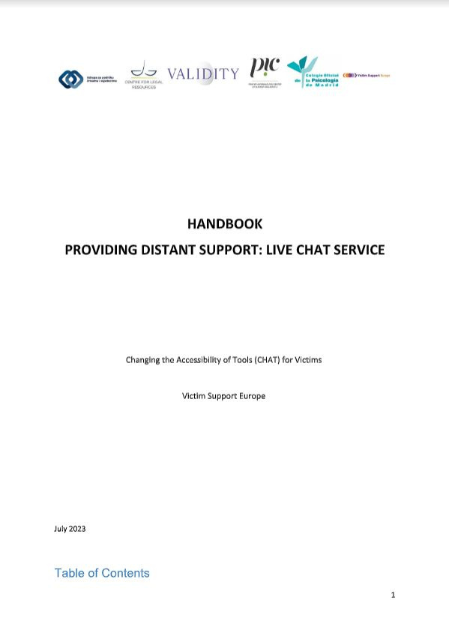

  Handbook: Providing Distant Support - Live Chat Service
    Created based on national and international desk research (preliminary research), interviews with experts, and focus groups with people with disabilities.
    Practical guidelines for providing support via chat (required communication skills, as well as technical solutions, platform features, types of support, etc.)
    Objective – To provide information and practical guidelines for professionals who wish to implement a chat service to support victims and witnesses.

Slide 7
What is needed for improving accessibility?
Universal Design
Designing services that are inherently accessible to all, without the need for adaptations or retrofitting.
Advocating for legal frameworks that require accessibility standards for all public and private victim support services
Legal Protections and Policy Reform:
Advocating for stronger laws that ensure persons with disabilities have equal access to justice and victim support and addressing existing gaps in the legal system.
Funding and Resources:
Ensuring that there is adequate funding and resources allocated specifically for disability-inclusive victim support programs
Community Engagement and Awareness:
Creating public awareness campaigns to reduce stigma and raise awareness about the unique needs of women, children, and people with disabilities in the context of victimization
Empowering local communities to support persons with disabilities by educating them about their rights and available resources.

Slide 8
Thank you!
National Call Centre for Victims of Crime - 116 006
pzs.hr
e-mail: npc@pzs.hr

