Slide 1


Disabled Women and Violence: Facilitators of Access to Justice
DIS-CONNECTED – Violence against women and children Conference
PhD Student: Eliona Gjecaj
Supervisor: Prof. Emerita Rannveig Traustadóttir
Co-supervisor: Prof. Anna Lawson
Centre for Disability Studies
University of Iceland
Email: eliona@hi.is
Notes:
main

Slide 2



My Research description:
Part of DARE (Disability Advocacy Research Europe) Project
Based in Iceland.
Focuses on voicing and capturing the experience of disabled women as well as those supporting them thorough detection, reporting and prosecuting violence.
Human Rights Approach: combining Disability Studies, Gender Studies, and Disability Law and Policy.
Qualitative Methods: Semi-structured interviews, document analyses and field observation.

Slide 3
Three groups of participants
Data Collection in Iceland
38 Interviews:
(1) Self-identified Disabled Women who were subjected to violence:
A) those who went to court
B) those who did not
(2) Professionals working on:
A) Support Frameworks
B) Prosecution Structures
e.g., Rights Protection officers (RPO), Staff at women’s shelter and Stígamót and Bjarkarhlíð, police, lawyers, prosecutors etc.
(3) Others background info including:
Experts on the justice system, people working in the disability field with some expertise in this topic and family members.
18
15
5

Slide 4
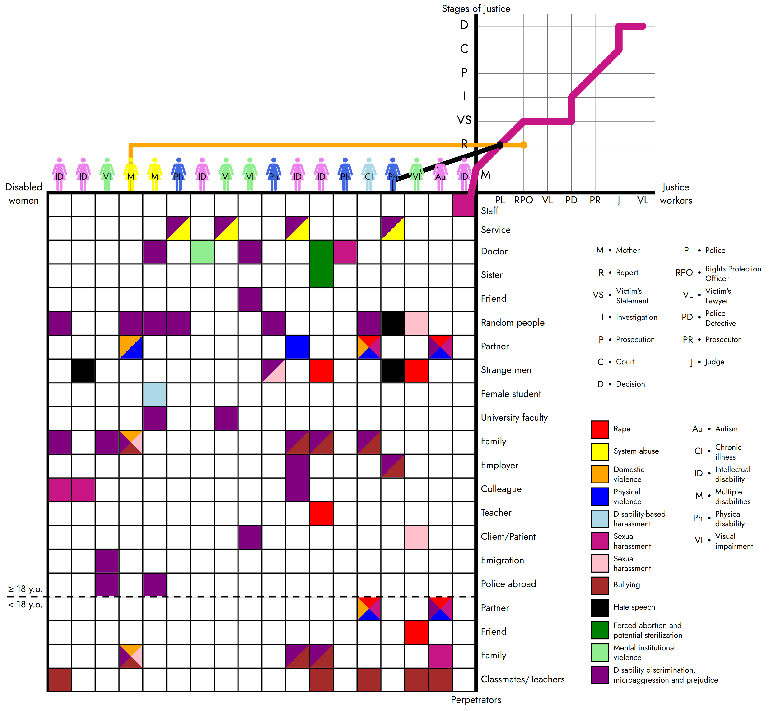
Findings

Slide 5
Articles of PhD thesis
“We Got Lucky with the Judge”: Access to Justice for Disabled Women in Iceland
“They guarantee understanding both ways”: Rights Protection Officers as Facilitators of Access to Justice for Disabled Women.
Available at: https://www.mdpi.com/2075-471X/12/2/21 and https://sjdr.se/articles/10.16993/sjdr.1051
RPO‘s

Slide 6
RPO‘s function throughout the process
Support to the disabled woman
RPO‘s
Request of procedural and reasonable accommodations
Informing and advising justice workers how, what and why

Slide 7
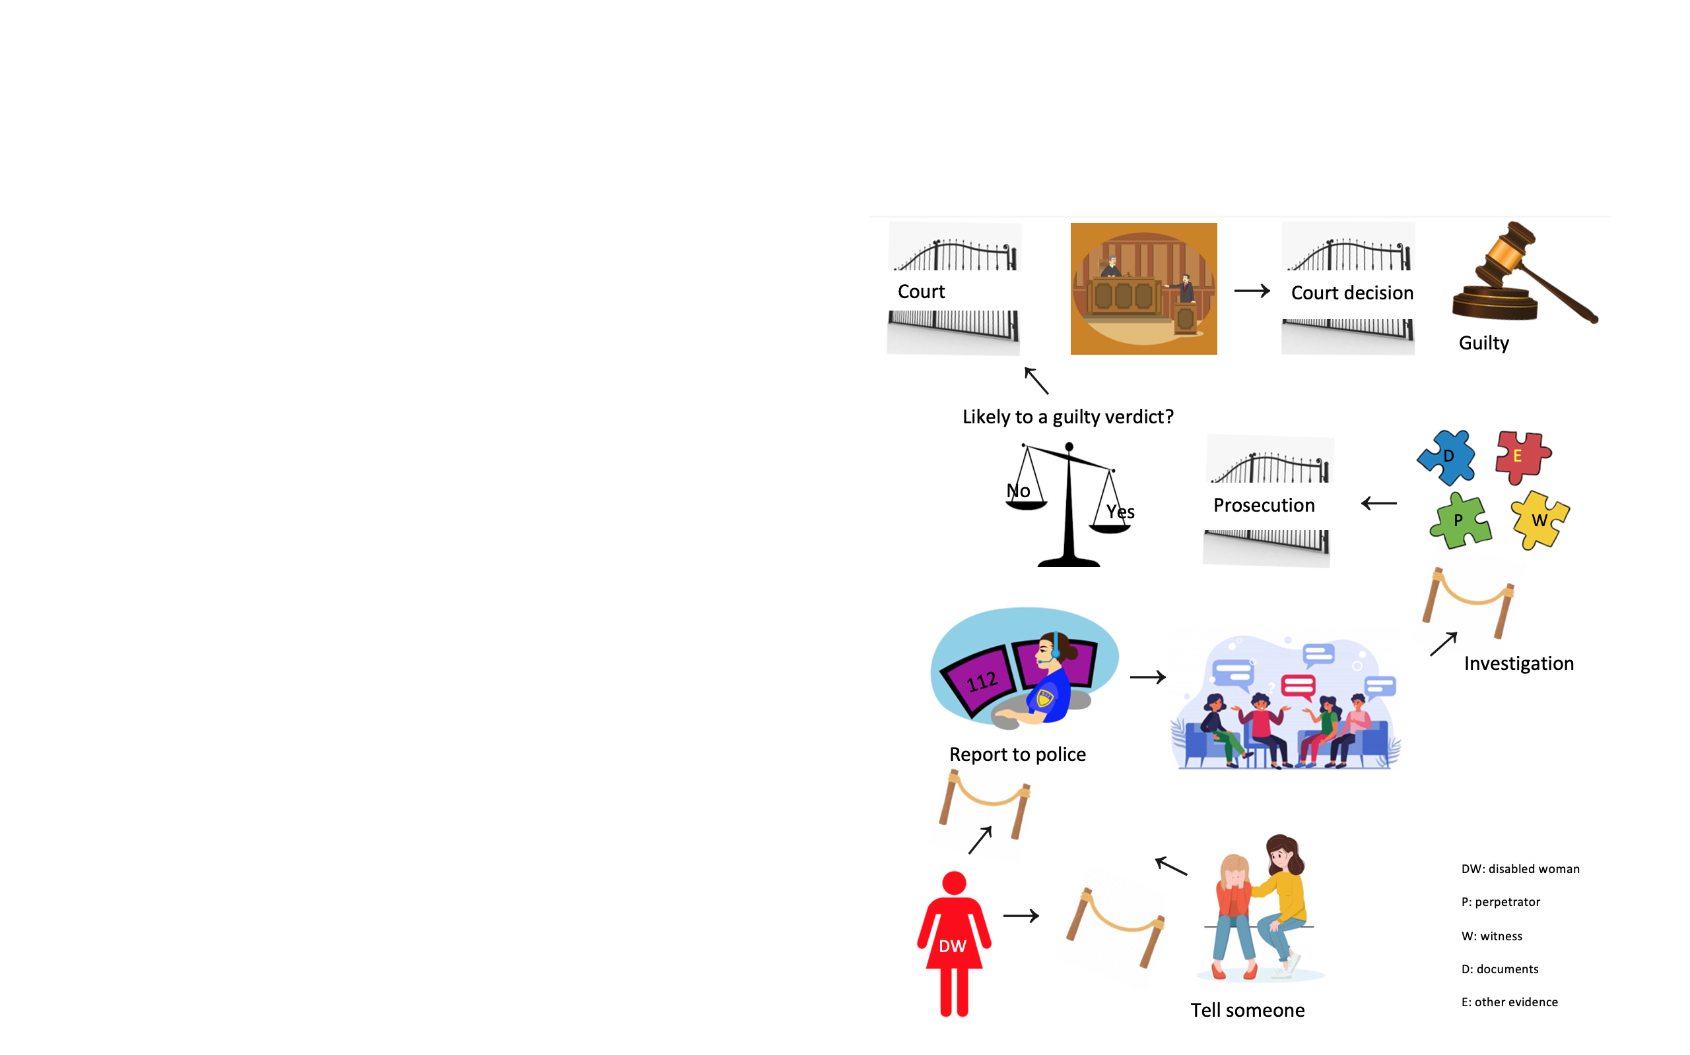
RPO‘s function throughout the process
Describe and discuss the role of RPOs regarding:
  Generally, the role of RPOs, contact, assignment and consent.
  Follow-up actions before and after police
  Police stage
  Prosecution stage: case dropped
  Court: before and in court
  Limitations to their role
6 barriers to justice.

Slide 8
Facilitators
RPOs (réttindagæslumaður) and Police
They have a right to have a lawyer when we interview them, but those lawyers are, can we say, ‘just lawyers’ and they are not often able to communicate with the client. I was very willing in my investigations to have someone to advise me how I can talk to this person. The most important person besides the victim is [the RPO]. … We are respecting each other’s field, in my opinion.
It is very different between police officers on whether our role is accepted or not in this situation.
RPOs:
The process usually starts with the person or the police. For example, in the case of violence the police contact us and asks us to be a part of the investigation, to support the individual in the interview, to evaluate and to provide knowledge about the individual, so they can receive the right support.
Police:
They guarantee understanding both ways.

Slide 9

‘Access to justice should rest on systematic protections, not accident or happenstance.’
-Gjecaj et al. 2023.
Open to Questions
Thank you

