Slide 1

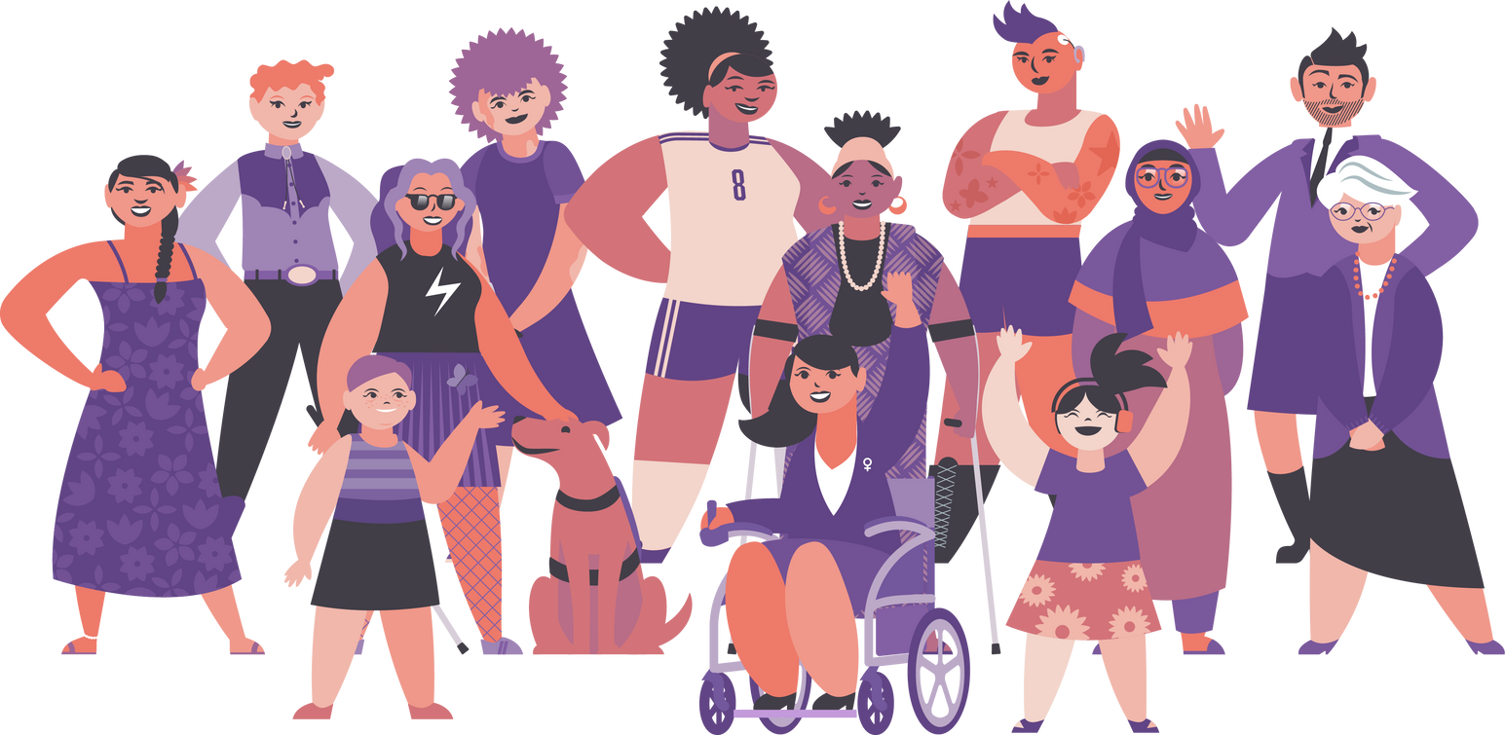
Session 1:
Gender- and
disability-based violence
in institutions
and services
DIS-CONNECTED Conference
21 November 2024

Slide 2

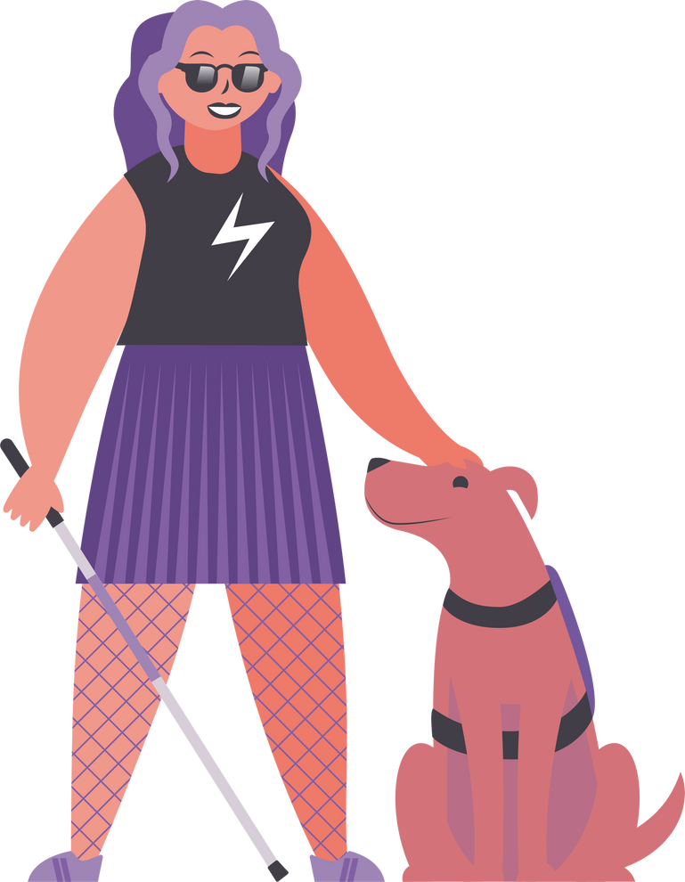
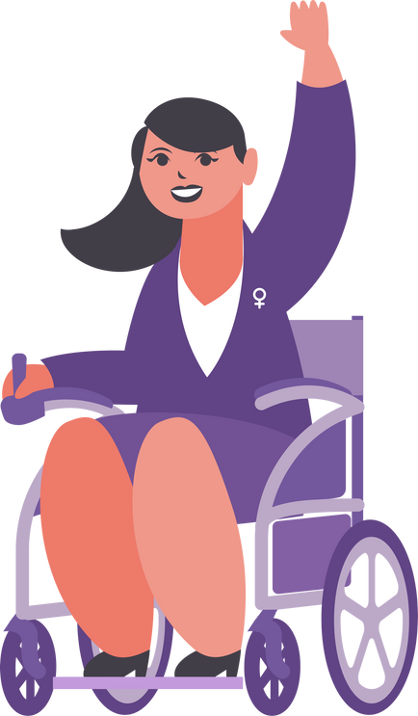
Mission
As feminists with disabilities and allies, we advance human rights and justice at the intersection of gender and disability to challenge exclusionary, unjust systems and support the leadership and center the voices of women, girls, and gender-diverse people with disabilities globally.

Slide 3
Agenda
General Overview: The Right to Legal Capacity
General Overview: Legal Capacity Intersections
Institutionalization
SRHR and GBV
Access to Justice
Early Findings: Legal Capacity and
Women with Intellectual Disabilities in Spain

Slide 4
General Overview
The Right to Legal Capacity
  Convention on the Rights of Persons with Disabilities (CRPD) Article 12
  CRPD Committee General Comment No. 1
    Legal capacity is an inherent right according to all people, including persons with disabilities…it consists of two strands. The first is legal standing to hold rights and to be recognized as a legal person before the law…The second is legal agency to act on those rights and to have those actions recognized by the law.
  Denials of the right to legal capacity occur through:
    Formal practices (i.e. guardianship)
    Informal practices (“de facto” guardianship)
        Family members
        Healthcare professionals
        Service providers

Slide 5
General Overview
Legal Capacity Intersections
  Institutionalization
Denials of legal capacity “perpetuate discrimination and exclusion against persons with disabilities and pave the way to different forms of abuse, corruption, exploitation, coercion, and institutionalisation.”*
Women and gender-diverse people with disabilities who are institutionalized are at higher risk of denials of legal capacity.
*General Assembly, Report of the Special Rapporteur on the
Rights of Persons with Disabilities, A/HRC/37/56 (12 Dec. 2017) ¶ 16.

Slide 6
General Overview
Legal Capacity Intersections
  Sexual and Reproductive Health and Rights (SRHR) and Gender-Based Violence (GBV)
“…Women with disabilities are at a heightened risk of violence, exploitation and abuse compared with other women, and of gender-based violence and harmful practices, such as forced contraception, forced abortion and sterilization, during institutionalization. They are denied the right more often than men with disabilities and more often than other women to exercise their legal capacity, leading to denial of access to justice, choice and autonomy. These risks should be considered when designing and implementing deinstitutionalization plans.”
- 2022 CRPD Guidelines on deinstitutionalization, ¶ 42
  Denials of Legal Capacity and SRHR
    Forced, coerced, or otherwise involuntary sterilization, abortion, or contraception
      “…forced sterilization is an act of violence, a form of social control, and a violation of the right to be free from torture and other cruel, inhuman, or degrading treatment or punishment.”
        - Report of the Special Rapporteur on torture and other cruel, inhuman or degrading treatment or punishment, Juan E. Méndez, A/HRC/22/53 (Feb. 1, 2013), ¶ 48
Denials of Legal Capacity and GBV
  Prevalence and risk of GBV
  Access to justice for GBV

Slide 7
General Overview
Legal Capacity Intersections
  Access to Justice
  Capacity to initiate legal proceedings or testify in them
  Reporting GBV
  Witness credibility

Slide 8
Early Findings
Legal Capacity & Women with Intellectual Disabilities in Spain
  Key Reflections & Takeaways
  The deep impact of institutionalization
  The inextricable links between SRHR and GBV
  The effect of harmful stereotypes on credibility

Slide 9

Thank you!

