Slide 1


Best practices in contacting with disabled people victims of hate motivated crime and violence
Aleksandra Ivanković, Deputy Director
Victim Support Europe, Brussels

Slide 2




Victimisation of persons with disabilities
  1 in 10 EU citizens has some form of disability
  2 to 7 times more likely to become victims
  Persons with intellectual disabilities are most likely to become victims

Slide 3
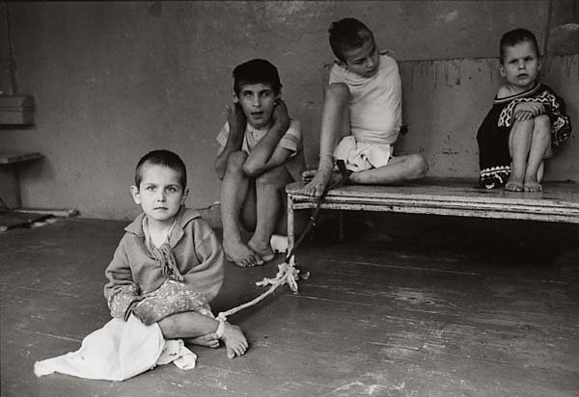



Specific forms of victimisation
  Institutionalisation
  Sexual and reproductive health
  Parental rights
  Hate crimes

Slide 4
Victims’ Rights Directive
Rights
Needs
Victim support

Slide 5

Rights in criminal proceedings
    Right to be heard
    Right to question decision not to prosecute
    Right to safeguards in the context of restorative justice
    Right to legal aid
    Right to reimbursement of expenses
    Right to return of property
    Right to decision on compensation
    Individual needs assessment

Slide 6
Victims’ needs in proceedings
    “Personal situation and immediate needs, age, gender, possible disability and maturity of victims of crime should be taken into account while fully respecting their physical, mental and moral integrity”

Slide 7
Victims’ needs
Individual
needs
Needs of victims with disabilities
Needs of all victims
Personal characteristics: e.g. coping skills, specific health conditions etc.
For example: accessibility, procedural accommodations, legal recognition etc.
(1) Respect and recognition; (2) Protection; (3) Support (incl. information); (4) Access to Justice; (5) Compensation

Slide 8

Needs of victims’ with disabilities in proceedings
  Accessibility
  Procedural accommodations

Slide 9

BARRIERS

Slide 10
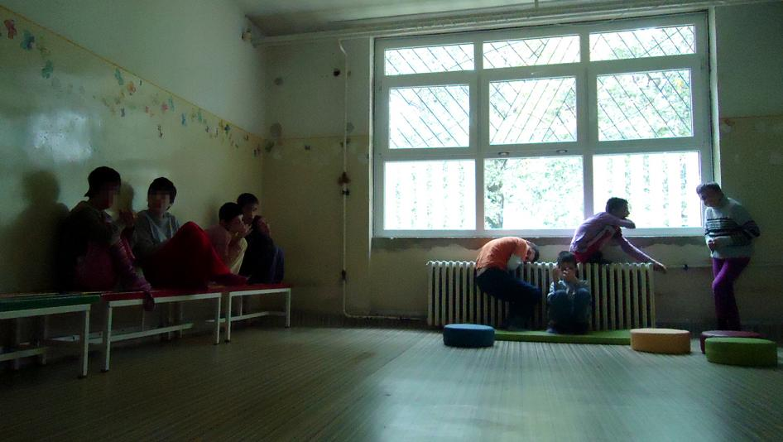
Identifying the victim

Slide 11

Barriers in criminal proceedings
  Power of Attorney and legal capacity
  Financial barriers
  Statutes of limitations

Slide 12

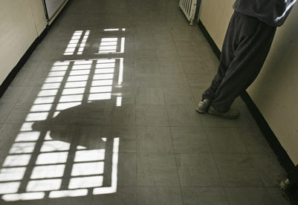
Guardianship as a barrier

Slide 13



Accessibility
    Physical
    Sensory
    Intellectual
    Universal design
Notes:
Personal situation and immediate needs, age, gender, possible disability and maturity of victims of crime should be taken into account while fully respecting their physical, mental and moral integrity
A person should be considered to be a victim regardless of whether an offender is identified, apprehended, prosecuted or convicted and regardless of the familial relationship between them
It should also be ensured that the victim can be understood during proceedings. In this respect, the victim's knowledge of the language used to provide information, age, maturity, intellectual and emotional capacity, literacy and any mental or physical impairment should be taken into account. Particular account should be taken of difficulties in understanding or communicating which may be due to a disability of some kind, such as hearing or speech impediments. Equally, limitations on a victim's ability to communicate information should be taken into account during criminal proceedings.

Slide 14



After the proceedings
  Individual care plan
  Compensation
  Secondary victimisation

Slide 15
Thank you!
  Aleksandra Ivanković
  Victim Support Europe
  a.ivankovic@victimsupporteurope.eu

